Slide 1

E-commerce Marketing and Advertising Concepts

Slide 2
Consumer Behavior
Study of consumer behavior
Attempts to explain what consumers purchase and where, when, how much, and why they buy
Consumer behavior models
Attempt to predict or explain wide range of consumer behaviors or decisions
Based on background demographic factors, marketing stimuli, social network factors, and community factors
Profiles of Online Consumers
Consumers shop online primarily for convenience

Slide 3
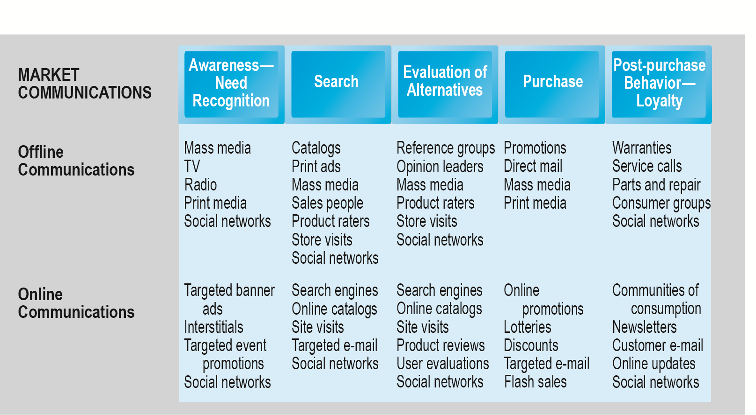
The Consumer Decision Process and Supporting Communications

Slide 4
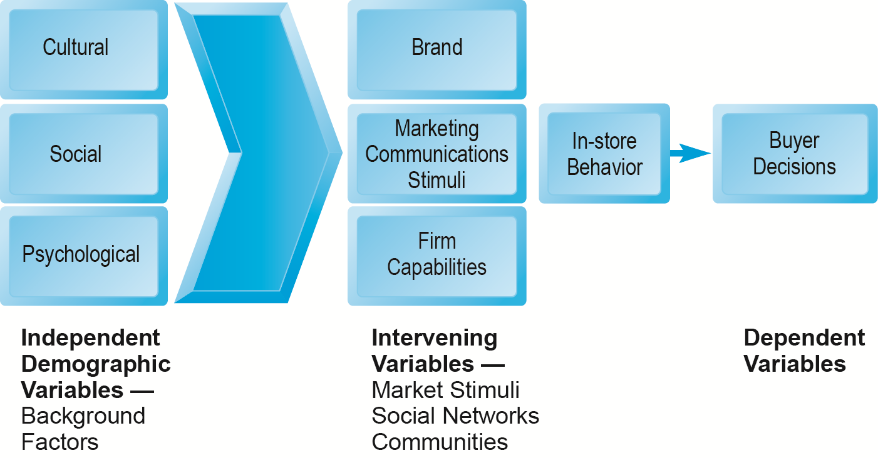
A General Model of Consumer Behavior

Slide 5
The Online Purchasing Decision
Five stages in consumer decision process
Awareness of need
Search for more information
Evaluation of alternatives
Actual purchase decision
Post-purchase contact with firm

Slide 6
The Online Purchasing Decision (cont.)
Decision process similar for online and offline behavior
General online behavior model includes
Web site features (delay, usability, and security)
Consumer skills regarding online purchasing
Product characteristics (prod desc, ability to be shipped over the internet)
Attitudes toward online purchasing
Perceptions about control over Web environment

Slide 7
The Online Purchasing Decision (cont.)
Clickstream behavior refers to the transaction log that consumers establish as they move about the web from search engine to websites, to pages, to the decision to buy

Slide 8
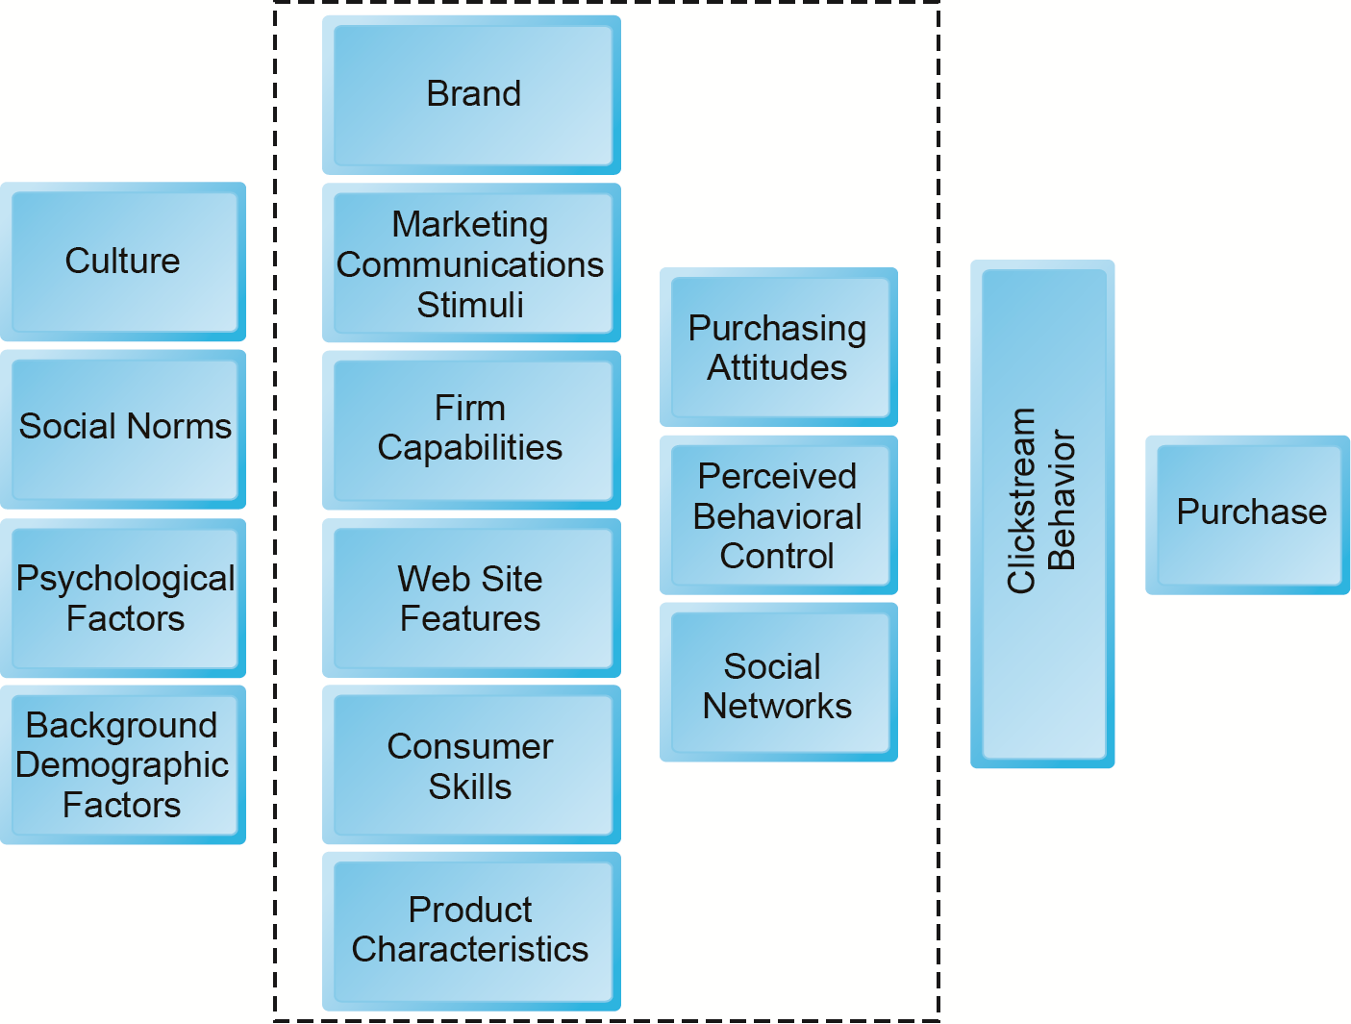
A Model of Online Consumer Behavior

Slide 9
Shoppers: Browsers and Buyers
Shoppers: 89% of Internet users
73% buyers
16% browsers (purchase offline)
One-third of offline retail purchases influenced by online activities
Online traffic also influenced by offline brands and shopping
E-commerce and traditional commerce are coupled: Part of a continuum of consumer behavior

Slide 10
What Consumers Shop for and Buy Online
Big ticket items ($1000 or more)
Travel, computer hardware, electronics
Consumers now more confident in purchasing costlier items
Small ticket items ($100 or less)
Apparel, books, office supplies, software, and so on
Types of purchases depend on level of experience with the Web

Slide 11
How Consumers Shop
How shoppers find online vendors
Search engines
Marketplaces (Amazon, eBay)
Specific retail site
27% of Internet users don’t shop online
Trust factor
Hassle factors (shipping costs, returns, etc.)

Slide 12
Trust, Utility, and Opportunism in Online Markets
Two most important factors shaping decision to purchase online:
Utility:
Better prices, convenience, speed
Trust:
Most important factors: Perception of credibility, ease of use, perceived risk
Sellers can develop trust by building strong reputations for honesty, fairness, delivery

Slide 13
Digital Commerce Marketing and Advertising: Strategies and Tools
Internet marketing (vs. traditional)
More personalized
More participatory
More peer-to-peer (P2P encourages customers to engage other customers by advocating a product or service to friends or associates)
More communal (A company directs its communal marketing efforts to a small sub-set of its customers who then spreads the word to potential new customers)
The most effective Internet marketing has all four features

Slide 14
Multi-Channel Marketing Plan
Web site
Traditional online marketing
Search engine, display, e-mail, affiliate
Social marketing
Social networks, blogs, video, game
Mobile marketing
Mobile/tablet sites, apps
Offline marketing
Television, radio, newspapers

Slide 15
Establishing the Customer Relationship
Web site functions to:
Establish brand identity and customer expectations
Differentiating product
Inform and educate customer
Shape customer experience
Anchor the brand online using various marketing messages using email, web, social media
The web site is the central point for anchoring the brand

Slide 16
Online Advertising
Online advertising
Display (banners, videos), search engine marketing, mobile messaging, sponsorships, classifieds, lead generation (generation of consumer interest or inquiry into products or services of a business), e-mail, affiliate, and viral marketing
Online ads are the fastest growing form of advertising
Advantages:
18–34 audience is online
Ad targeting (sending messages to specific groups)
Price discrimination
Personalization

Slide 17
Traditional Online Marketing and Advertising Tools
Search engine marketing and advertising
Display ad marketing
E-mail marketing
Affiliate marketing
Viral marketing
Lead generation marketing
Social, mobile, and local marketing and advertising

Slide 18
Search Engine Marketing and Advertising
Use of search engines for branding
http://searchengineland.com/top-5-ways-to-use-search-for-branding-66332
Search engine advertising
Use of search engines to support direct sales
Types of search engine advertising
Sponsored links or paid inclusion(A paid advertisement in the form of a hypertext link that shows up on search results pages)
Keyword advertising (purchase key words by bidding at search sites)
Network keyword advertising (publisher accepts ads placed on its site and receive a fee for any click-throughs from the ad)

Slide 19
Search Engine Marketing (cont.)
Search engine optimization (SEO) process of improving ranking of web pages with search engines
Social search
Utilizes social graph (friend’s recommendations, past Web visits, Facebook Likes) to provide fewer and more relevant results
Search engine issues
Paid inclusion (company charges fees related to the inclusion of websites in their search index)
Link farms (group of web sites all hyperlinked to each other in the group)
Content farms (large amounts of textual content which is specifically designed to satisfy algorithms for maximal retrieval by automated search engines)
Click fraud (using script file to click on website that get paid by how many visitors to the sites click on the ads)

Slide 20
Search Engine Marketing (cont.)
Search engine issues
Link farms are websites that link to one another
Content farms are companies that generate volumes of textual content for multiple websites to attract viewers and search engines
They profit by attracting large numbers of readers and exposing them to ads
Click fraud occurs on the Internet in pay-per-click (PPC) online advertising when a competitor clicks on a search engine ads forcing the advertiser to pay for the click even when it is not legitimate.
The process could be automated costing advertisers lots of money

Slide 21
Display Ad Marketing
Banner ads take customers to advertiser web site
Rich media ads employ animation & sound
Video ads
Sponsorships ads (sponsoring an event)
Advertising networks help companies take advantage of internet marketing/advertising
Advertising exchanges and real-time bidding

Slide 22
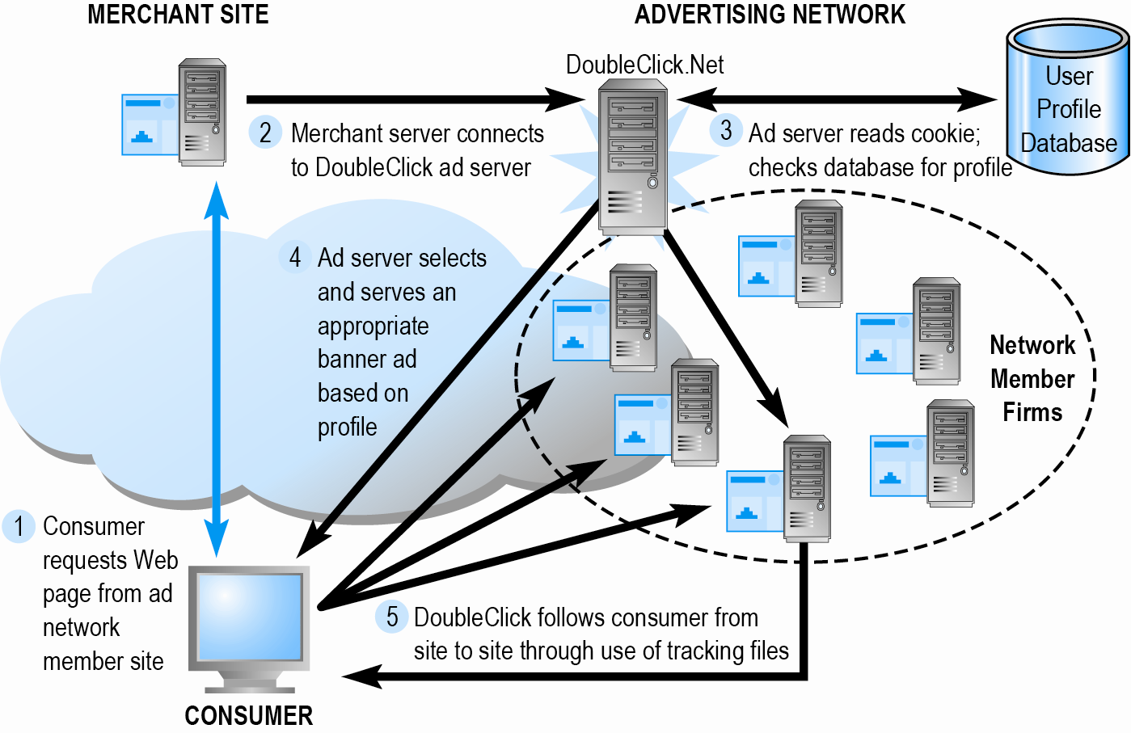
How an Advertising Network Such as DoubleClick Works

Slide 23
E-mail Marketing
Direct e-mail marketing
Messages sent directly to interested users
Benefits include
Inexpensive
Average more than 7% click-throughs for in-house lists
Measuring and tracking responses
Personalization of messages and offers
Three main challenges
Users hate Spam
Anti-spam software prevent spam email from getting through
Poorly targeted purchased e-mail lists

Slide 24
Spam
Unsolicited commercial e-mail
65–70% of all e-mail
Most originates from bot networks
Efforts to control spam have largely failed:
Government regulation (CAN-SPAM)
State laws
Voluntary self-regulation by industries (DMA )

Slide 25
Other Types of Traditional Online Marketing
Affiliate marketing
Commission fee paid to other Web sites for sending customers to their Web site
Viral marketing
Marketing designed to inspire customers to pass message to others
Lead generation marketing
Services and tools for collecting, managing, and converting leads into purchases

Slide 26
Social Marketing and Advertising
Involves the use of social networks to build brands and drive revenue
Fastest growing type of online marketing
Targets the enormous audiences of social networks
Four features driving growth
Social sign-on (Facebook & twitter links to login to site)
Collaborative shopping (friends chat online about prods)
Network notification (consumers share their approval/disapproval of prods)
Social search (recommendations advice from friends and family)

Slide 27
Social Marketing and Advertising (cont.)
Blog marketing (reaching business' prospects through the use of blogs)
Educated, higher-income audience
Ideal platform to start viral campaign
Game marketing
Large audiences for social games (FarmVille, Words with Friends)
Used for branding and driving customers to purchase at restaurants and retail stores

Slide 28
Mobile Marketing and Advertising
Major formats:
Display, rich media, video
Games
E-mail
Text messaging (SMS)
In-store messaging
Quick Response (QR) codes
Couponing
Mobile app marketing
Using App Store Optimization to create an App Store listing that draws new users in and makes your app findable
Aims to drive more revenue and engagement from the people who already use your app

Slide 29
Local Marketing
Geared to user’s geographic location
Local search and purchasing
Local searches:
25% of all searches
50% of mobile searches
Most common local marketing tools
Geo-targeting with Google Maps
Geo-targeting refers to the practice of delivering different content to a website user based on his or her geographic location.
Hyperlocal Display ads (next slide)

Slide 30
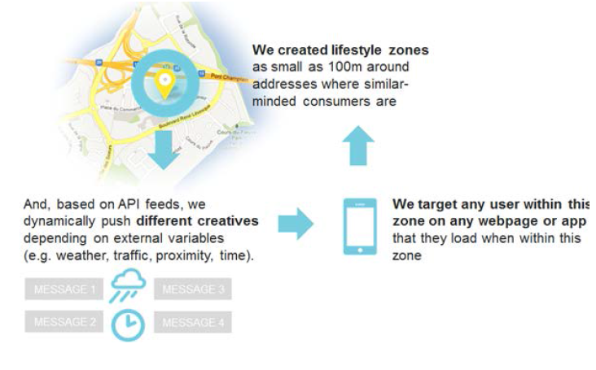
Hyperlocal Display Ads

Slide 31
Multi-Channel Marketing
People spend more media time on digital media channels
Consumers also multitask, using several media
Internet campaigns strengthened by using other channels
Most effective are campaigns using consistent imagery throughout channels

Slide 32
Other Online Marketing Strategies
In addition to traditional online advertising and marketing strategies (search engine, display, etc.), several other strategies are more focused than “traditional” online strategies
Customer retention
Pricing
The “long tail”

Slide 33
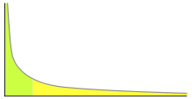
Other Online Marketing Strategies
The “long tail” is a graph showing popularity ranking. To the right (yellow) is the long tail; to the left (green) are the few that dominate. In statistics, a long tail of some distributions of numbers is the portion of the distribution having a large number of occurrences far from the "head" or central part of the distribution.

Slide 34
Long-Tail Marketing
Internet allows for sales of obscure products with little demand, the long tale
Long tail marketing concentrates on these less popular products, developing a business sales model based upon products in the “long tail.”
Substantial revenue because
Near zero inventory costs
Little marketing costs
Search and recommendation engines

Slide 35
Other Online Marketing Strategies
Customer retention strategies
Personalization and one-to-one marketing
Retargeting showing same ads across multiple websites
Behavioral targeting (interest-based advertising)
uses data from search engine queries, clickstream history, social network, and integration of offline personal data to target customers
Privacy issues are a concern

Slide 36
Other Online Marketing Strategies (cont.)
Customization: Changing the product not just the message based on user preference
Customer co-production: Customers help create or customize the product
Customer service
FAQs
Real-time customer chat systems
Automated response systems

Slide 37
Pricing Strategies
Pricing
Integral part of marketing strategy
Traditionally based on:
Fixed cost
Variable costs
Demand curve
Price discrimination
Selling products to different people and groups based on willingness to pay

Slide 38
Pricing Strategies (cont.)
Free and freemium
Can be used to build market awareness
Freemium is where you get a free basic service and the premium version is not
Versioning
Creating multiple versions of product and selling essentially same product to different market segments at different prices
Bundling
Offers consumers two or more goods for one price
Dynamic pricing:
Auctions
Yield management (selling excess capacity)
Flash marketing (flash sale)

Slide 39
Internet Marketing Technologies
Internet’s main impacts on marketing:
Increase in scope of marketing communications
Increase in the richness of marketing communications
Expand information intensity of marketplace
Always-on mobile environment expands marketing opportunities

Slide 40
Web Transaction Logs
Built into Web server software
Record user activity at Web site
Provides much marketing data, especially combined with:
Registration forms
Shopping cart database
Answers questions such as:
What are major patterns of interest and purchase?
After home page, where do users go first? Second?

Slide 41
Tracking Files
Users tracked as they move from site to site
Four types of tracking files
Cookies
Small text file placed by Web site for understanding and identifying customers
Allows web marketers to gather data on users
Make shopping carts and quick checkout possible
Flash cookies new way of tracing your movement on the Internet and storing lots of information about you. (One disadvantage is that you can't locate them in your browser because they are clear and not easily seen in the list of cookies which you can access if you open the browser cookie manager, nor do they appear in databases or other browser-specific storage locations)

Slide 42
Tracking Files
Web Beacons (“bugs”) uses Adobe Flash software to keep track of users navigation through a single website or a series of websites. They also go by the name of web bugs and are normally used by websites that use third party traffic monitoring and tracking services.
Web beacons might be used in connection with cookies to gain an understanding of how website's users navigate through and process the content contained in that website. This came about because users delete cookies making browsing and tracking difficult

Slide 43
Databases
Database: Stores records and attributes
Database management system (DBMS):
Software used to create, maintain, and access databases
SQL (Structured Query Language):
Industry-standard database query and manipulation language used in a relational database
Relational database:
Represents data as two-dimensional tables with records organized in rows and attributes in columns; data within different tables can be flexibly related as long as the tables share a common data element

Slide 44
Data Warehouses and Data Mining
Data warehouse:
Collects firm’s transactional and customer data in single location for offline analysis by marketers and site managers
Data mining:
Analytical techniques to find patterns in data, model behavior of customers, develop customer profiles
Query-driven data mining
Model-driven data mining
Rule-based data mining

Slide 45
Customer Relationship Management (CRM) Systems
Create customer profiles:
Product and usage summary data
Demographic and psychographic data
Profitability measures
Contact history
Marketing and sales information
Customer data used to:
Develop and sell additional products
Identify profitable customers
Optimize service delivery, and so on

Slide 46
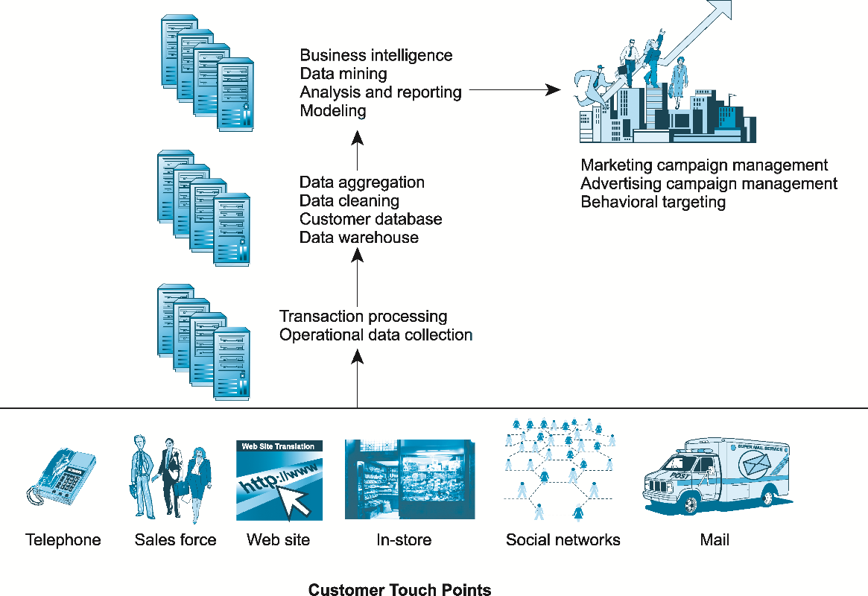
A CRM System

Slide 47
Online Marketing Metrics: Lexicon
Audience size or market share
Impressions (# of times Ad is served)
Click-through rate (CTR)
View-through rate (VTR)
Hits
Page views
Stickiness (duration)
Unique visitors
Loyalty
Reach
Recency
Conversion to customer
Acquisition rate (visiting pgs)
Conversion rate
Browse-to-buy ratio
View-to-cart ratio
Cart conversion rate
Checkout conversion rate
Abandonment rate
Retention rate
Attrition rate

Slide 48
Online Marketing Metrics (cont.)
Social marketing
Conversation ratio
Applause ratio (# likes/post)
Amplification (retweets/post)
Sentiment ratio (ratio of positive to total comments)
Often times, consumers just view the ad and do not click on the ad but later on go to the website and take the action – this has been termed as Post-Impression activities.
E-mail metrics
Open rate
Delivery rate
Click-through rate (e-mail)
Bounce-back rate

Slide 49
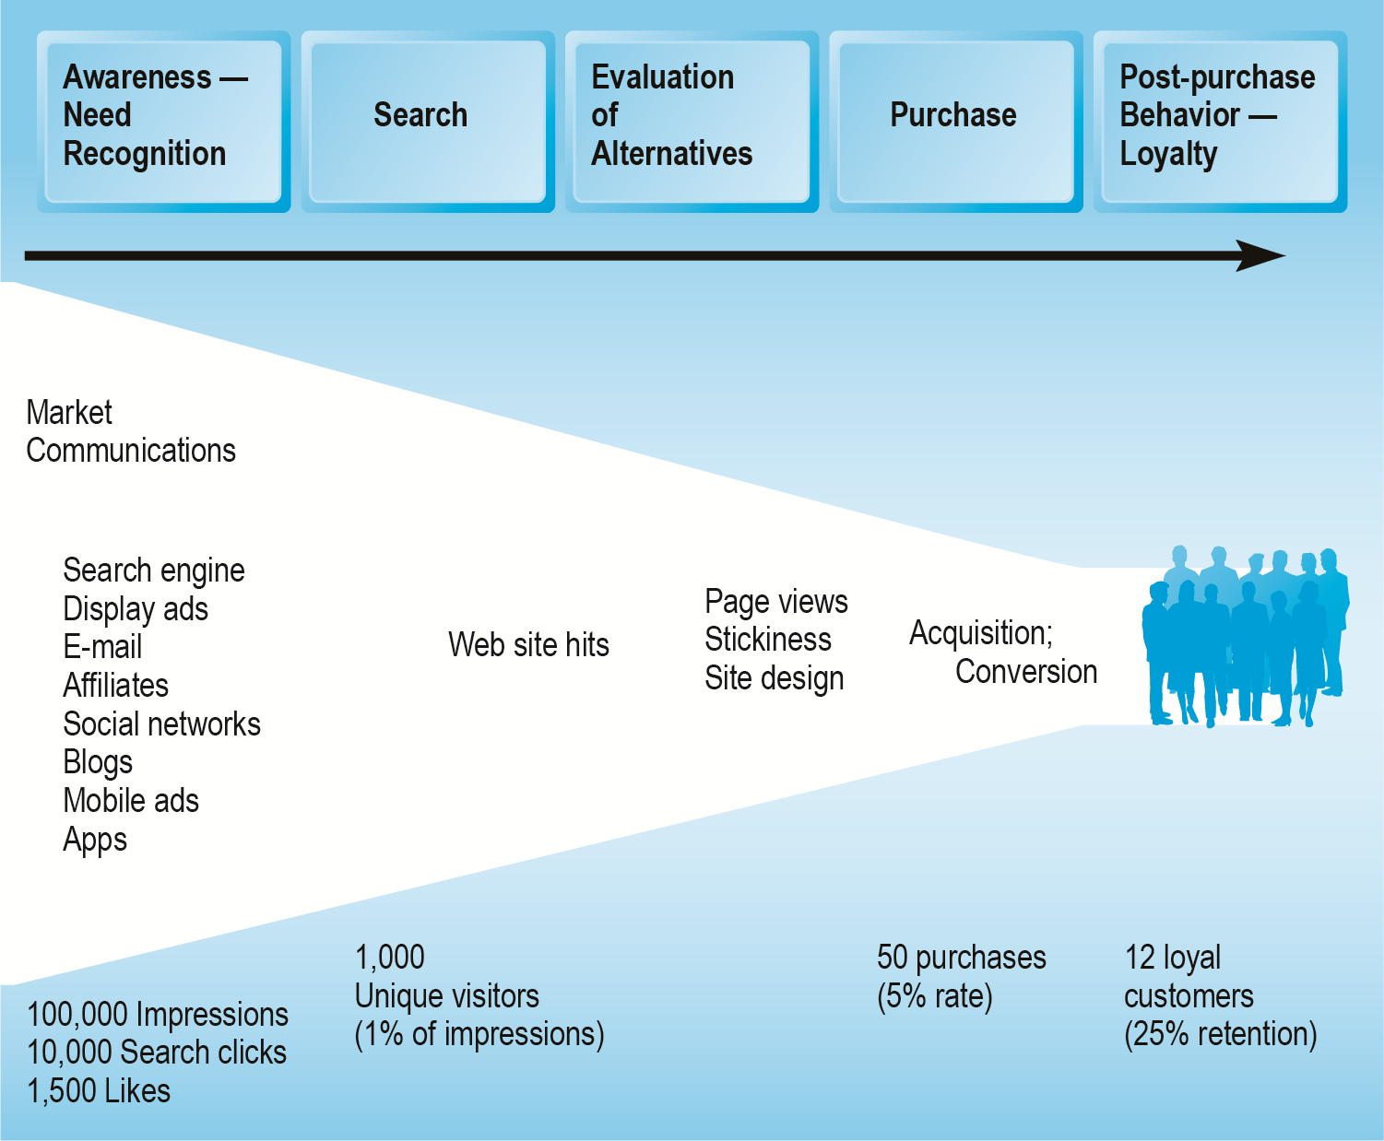
An Online Consumer Purchasing Model

Slide 50
How Well Does Online Advertising Work?
Use ROI to measure ad campaign
Highest click-through rates: Search engine ads, permission e-mail campaigns
Rich media, video interaction rates high
Online channels compare favorably with traditional
Most powerful marketing campaigns use multiple channels, including online, catalog, TV, radio, newspapers, stores

Slide 51
The Costs of Online Advertising
Pricing models
Barter (exchange ad space for something of similar value)
Cost per thousand (CPM)
Cost per click (CPC)
Cost per action (CPA)
Online revenues only
Sales can be directly correlated
Both online/offline revenues
Offline purchases cannot always be directly related to online campaign
In general, online marketing is more expensive on CPM basis, but more effective

Slide 52
Web Analytics
Software that analyzes and presents data on each stage of the customer conversion process
Awareness (new visitors)
Engagement (page views, duration, content views)
Interaction (posts, likes, comments, etc)
Purchase (purchase, enter cart pg, register, abandon cart)
Loyalty and post-purchase (repeat cust, service request, etc)
Helps managers
Optimize ROI on Web site and marketing efforts
Build detailed customer profiles
Measure impact of marketing campaigns
Google Analytics, IBM Coremetrics, Adobe Analytics

Slide 53
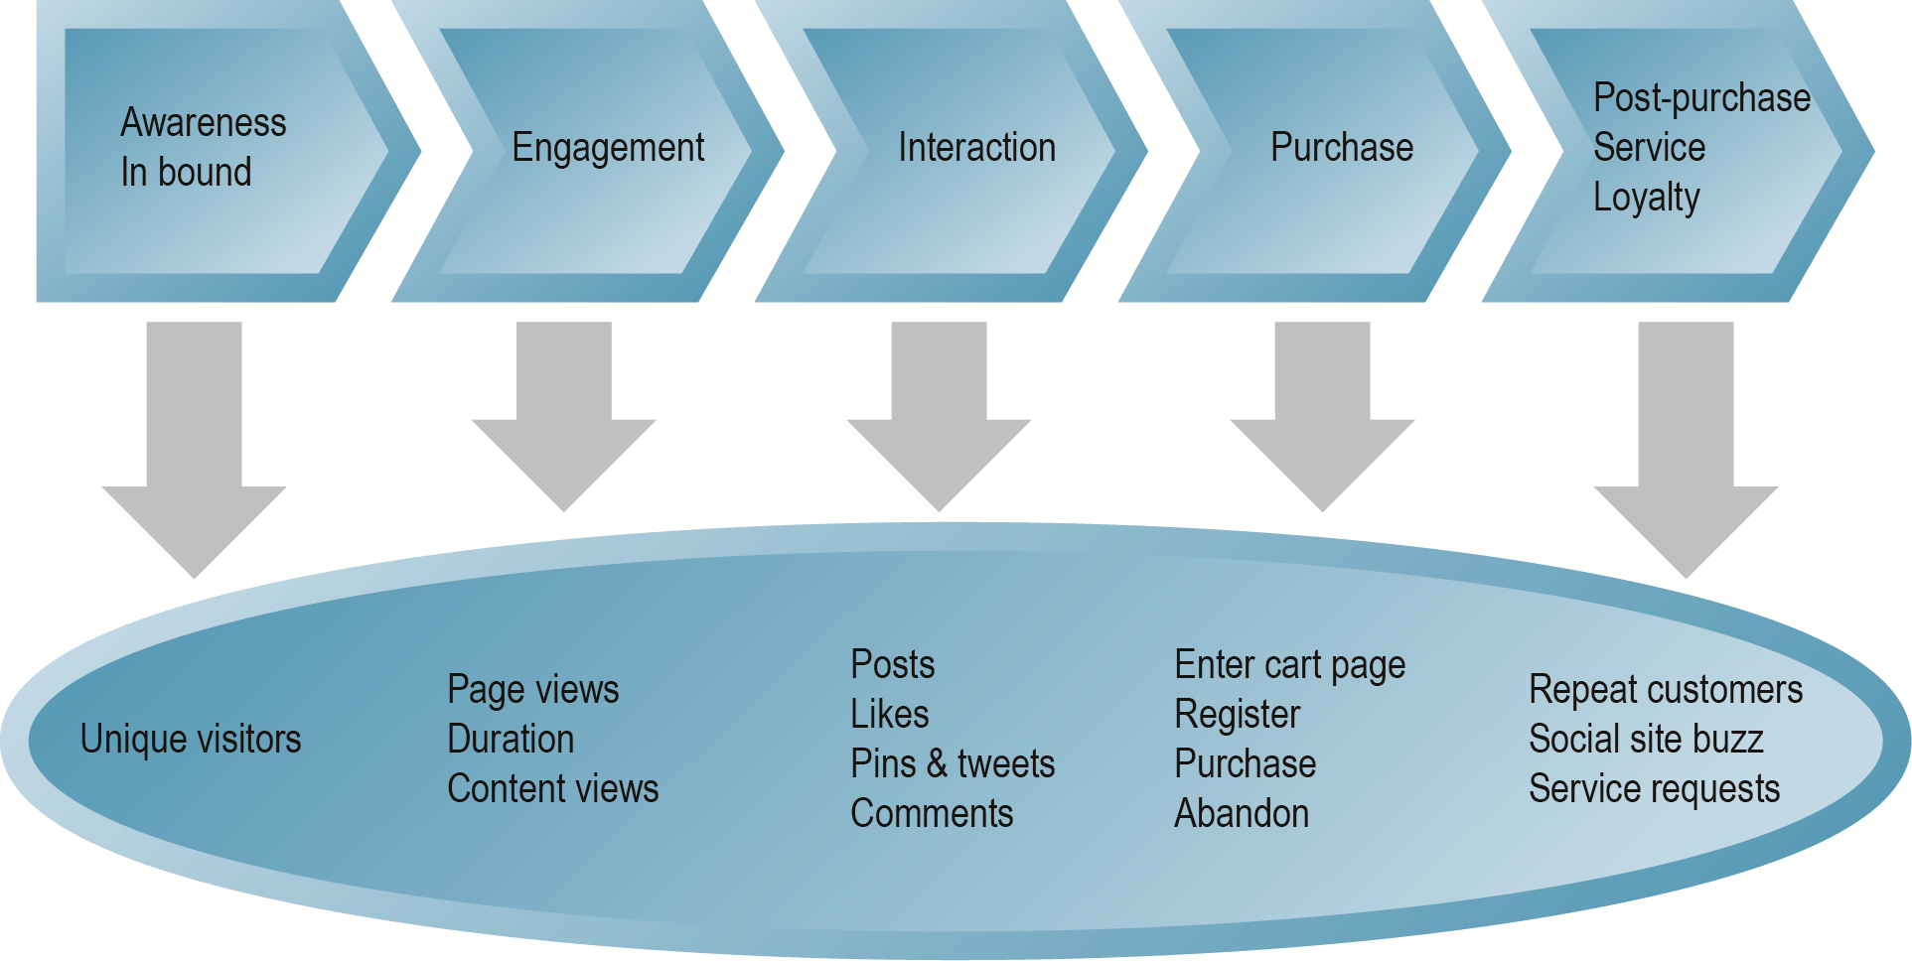
Web Analytics and the Online Purchasing Process
Figure 6.12, Page 397

